Slide 1

RTX-Team A
About Us
Portfolio
Contact Us
Search
County-Level Air Quality Prediction (CLAP)
Launch Demo
SE 4485.001 – Group 1:
Sponsor(s):
Merc Perna, TD
Trey Williams, C/E
Ryan Havens, SE
Trevor Lang, EA
Student(s):
David Santos
Amelia Quinn
Kevin Melo
AJ Kimbrough
Andrew Enright
Jay Chung
Instructor(s):
Dr. Eric Wong
Zizhao Chen
Chih-Wei Hsu

Slide 2

RTX-Team A
About Us
Portfolio
Contact Us
Search
Technical
Feasibility
Prototype
Forecasting next-day AQI :
End-to-end machine-learning (ML) predictive model
Predicts tomorrow’s average Air Quality Index (AQI)
Uses data from the U.S. Environmental Protection Agency (EPA)

Slide 3

RTX-Team A
About Us
Portfolio
Contact Us
Search
Project
Objectives
Data Pipeline:
Data persistence
ML Model:
Time-series regression
Decision-tree model
Dashboard:
12/25
>50%
Refresh control
WCAG 2.1 AA compliant
Project Deadline
Risk

Slide 4
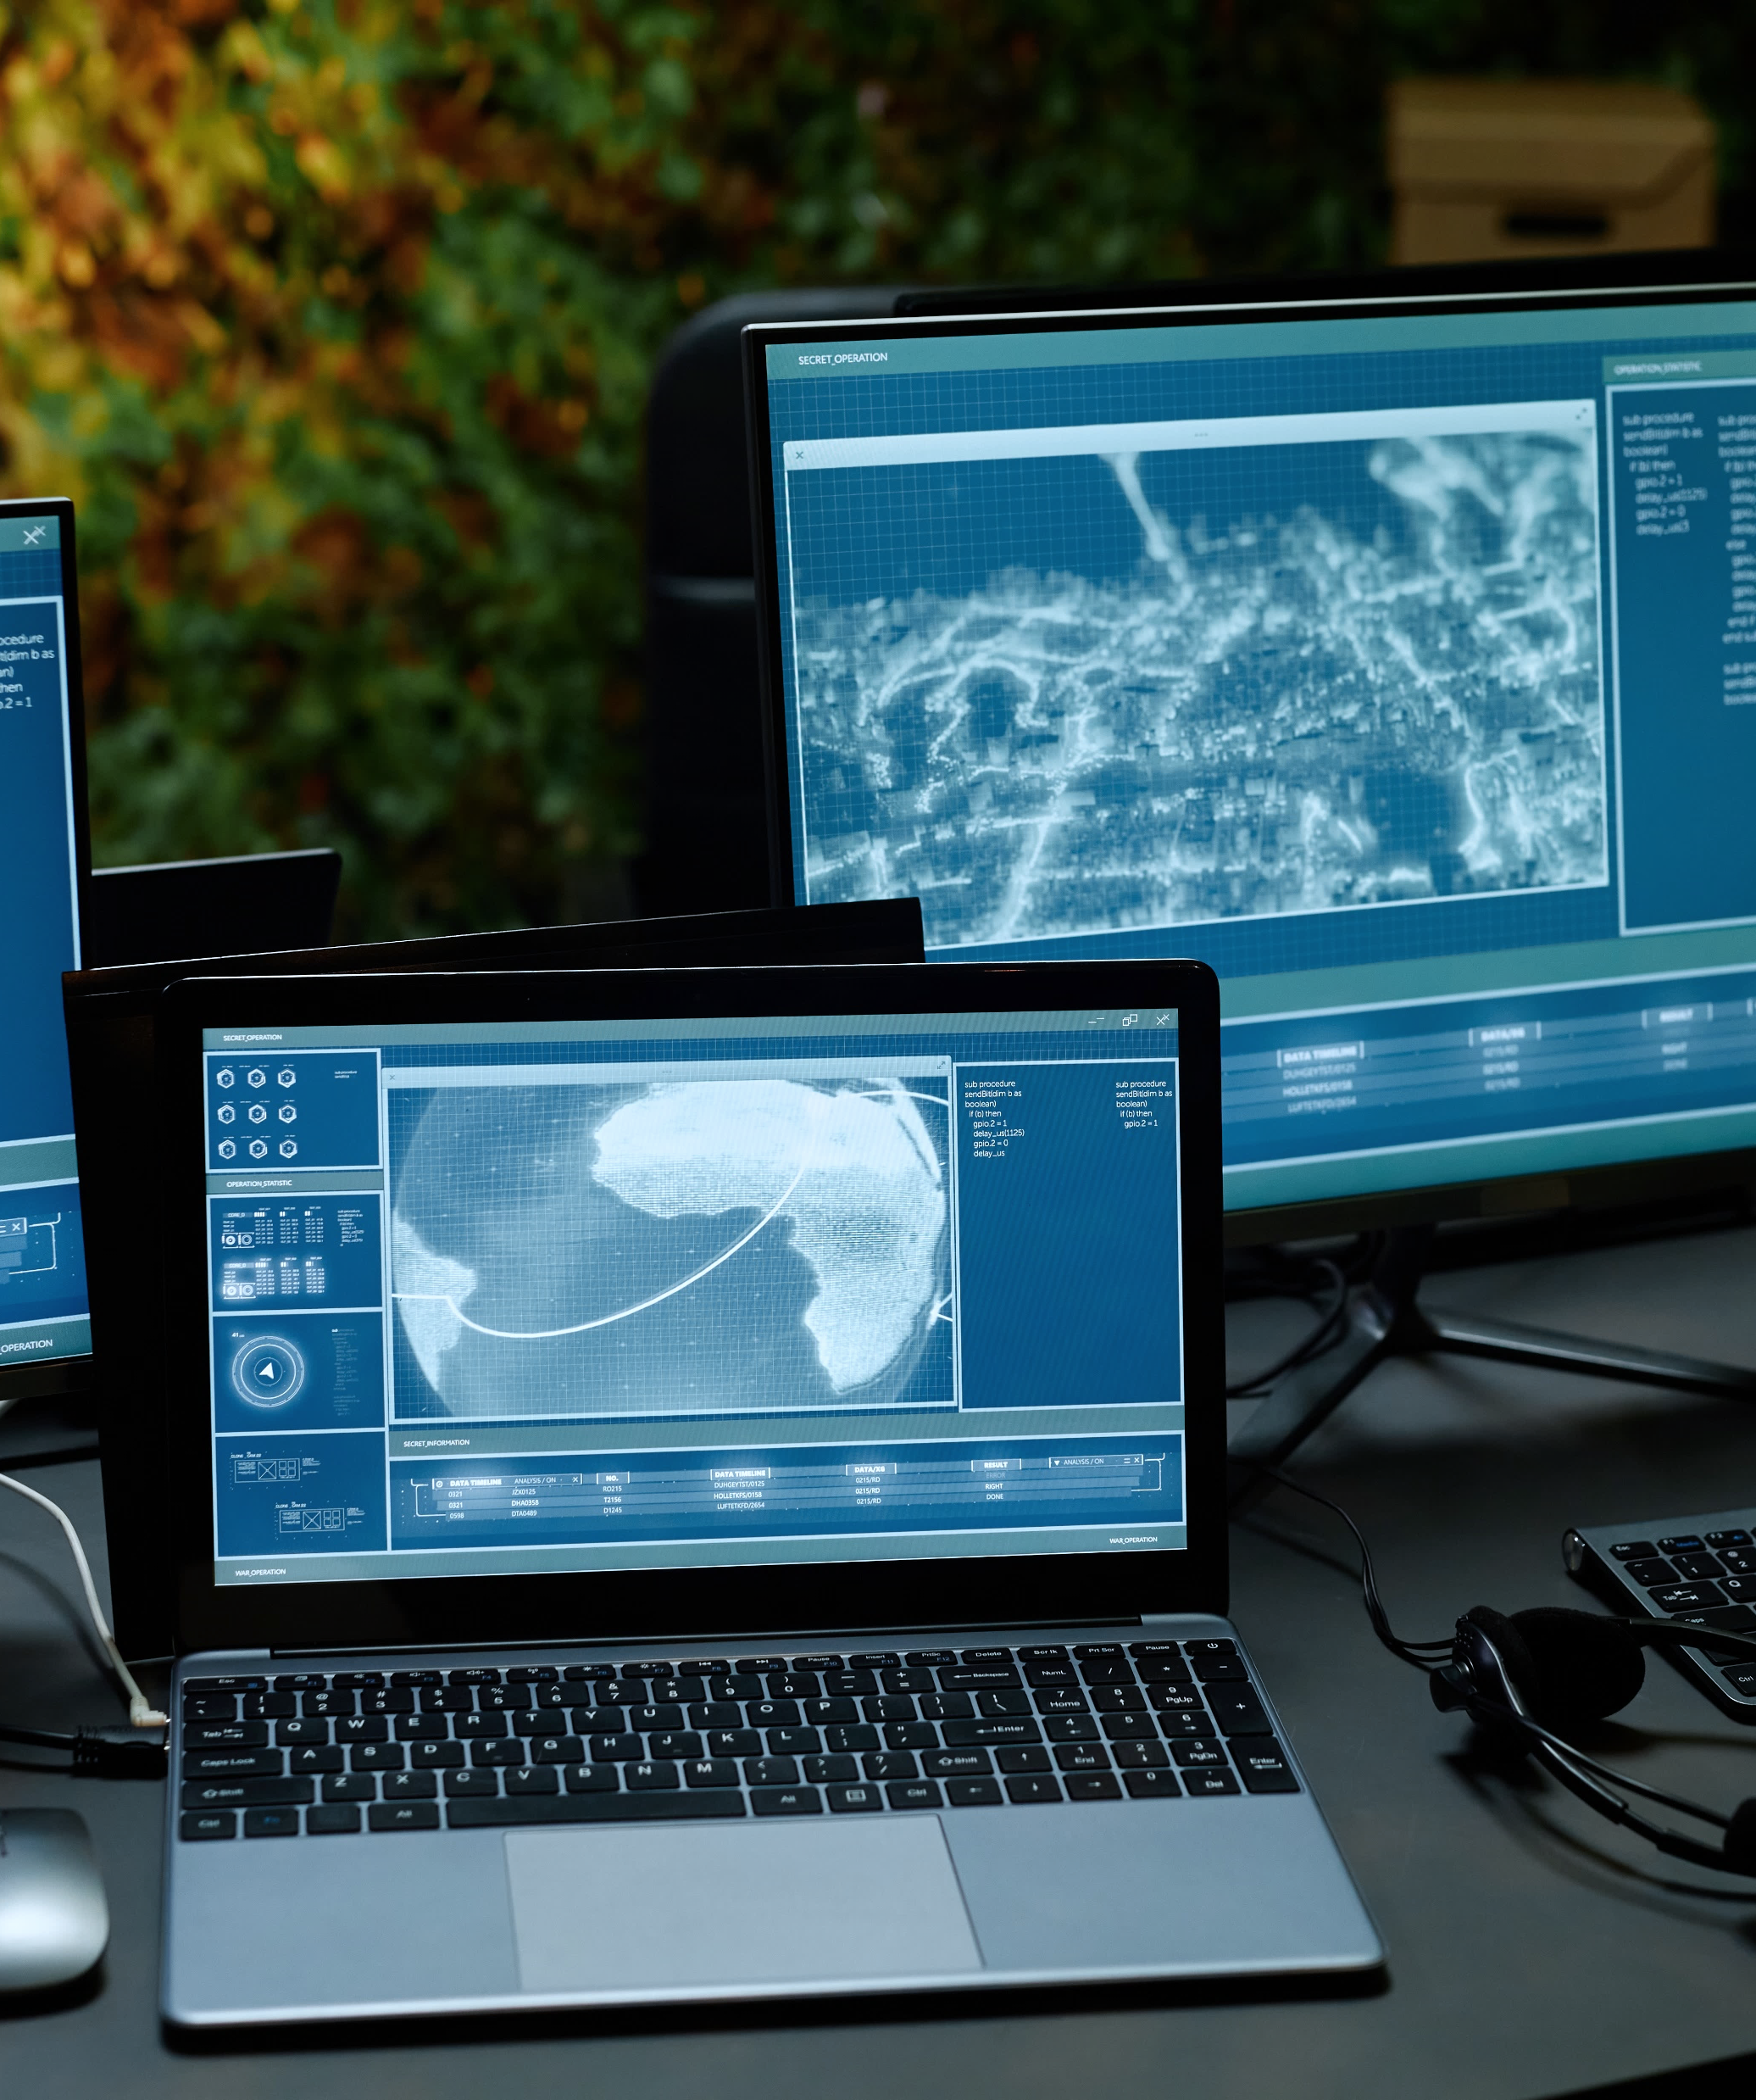



RTX-Team A
About Us
Portfolio
Contact Us
Search
Development
Process
Project Management Lifecycle:
Iterative model
ML lifecycle model
Configuration Management:
GitHub
Team Dynamics:
Effective communication
Weekly Sponsor Meetings

Slide 5
RTX-Team A
About Us
Portfolio
Contact Us
Search
Use Case
UC-1: Ingest Daily AQI
Scenarios
The maintainer manually updates ML-ready AQI dataset using the ingestion deployment pipeline.
Use-case scenarios capture
Functional & Non-functional requirements:
Data ingestion
Data processing
Predictive analytics
Dashboard interface.
UC-2: Provide County-Level Forecast
System allows end user to obtain a next-day average AQI forecast on demand and view recent county-level AQI trends.

Slide 6
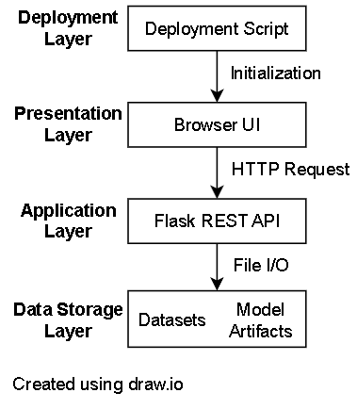
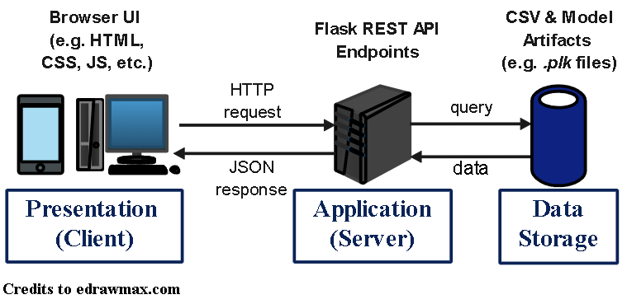

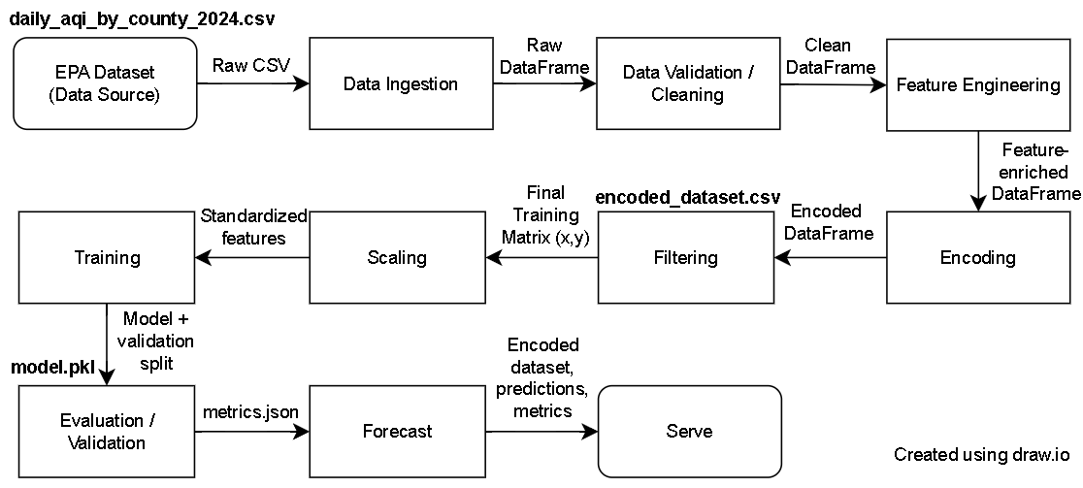


RTX-Team A
About Us
Portfolio
Contact Us
Search
System
Architecture
Layered Architecture
Data Storage
Application (Backend)
Presentation (Frontend)
Client-Server Architecture
Package-level decomposition
Stereotype: <<subsystem>>
Pipe & Filter Architecture
Ingestion & Processing
Feature Engineering

Slide 7
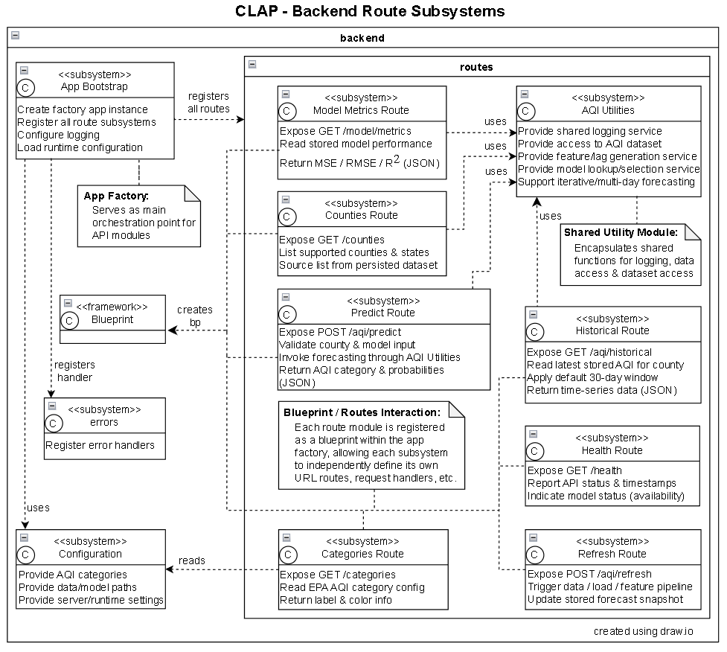


RTX-Team A
About Us
Portfolio
Contact Us
Search
Design:
Static Model
Backend Route Subsystems
Backend API components
Domain DTO
Route-specific JSON responses

Slide 8
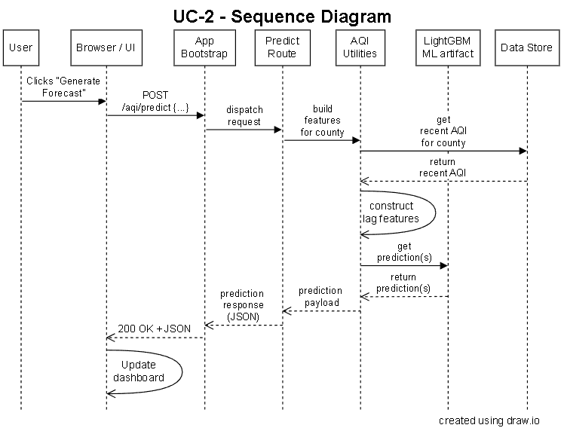

RTX-Team A
About Us
Portfolio
Contact Us
Search
Design:
Dynamic Model
UC-2 Runtime Interactions
Backend API components

Slide 9
RTX-Team A
About Us
Portfolio
Contact Us
Search
Challenges & Solutions
Dataset Limitation
Inadequate Model
Change requirements
Optimize hyperparameter
Team Conflict
Inconsistent Design
Increase communication
Increase project visibility
Capture semantic meaning
Staff Burnout
Incomplete Work
Prioritize deliverables
Develop early prototype
Keep Requirements Simple

Slide 10


RTX-Team A
About Us
Portfolio
Contact Us
Search
Questions & Answers
Thank you for your time!
CLAP_V1.2 is a machine-learning-powered web application that predicts Air Quality Index (AQI) for counties across the United States. CLAP features an ML model for real-time predictive forecasting for 700+ counties across the United States, and an interactive dashboard with EPA-compliant color-coding.
This project is part of SE 4485.001 coursework at the University of Texas at Dallas.

Slide 11
RTX-Team A
About Us
Portfolio
Contact Us
Search
References
[1] Larson, E. and Gray, C., 2014. Project Management: The Managerial Process. McGraw Hill
[2] Humphrey, W.S. and Thomas, W.R., 2010. Reflections on Management: How to Manage Your Software Projects,
Your Teams, Your Boss, and Yourself. Pearson Education
[3] Signh, A. (2022). Introduction to Machine Learning Lifecycle. [Figure]. In What is machine learning lifecycle?.
NashTech. Retrieved from https://blog.nashtechglobal.com/introduction-to-machine-learning-lifecycle/
[4] Lamsweerde, A.V., 2009. Requirements Engineering: From System Goals to UML Models to Software
Specifications. John Wiley
[5] A. J. Lattanze, Architecting Software Intensive Systems. CRC Press, 2008.
[6] L. Bass, P. Clements, and R. Kazman, Software Architecture in Practice, 3rd ed. Upper Saddle River (N.J.):
Addison-Wesley, 2013.
[7] Larman, C., 2012. Applying UML and Patterns: An Introduction to Object Oriented Analysis and Design and
Iterative Development. Pearson Education
[8] Hyman, B., 1998. Fundamentals of Engineering Design. New Jersey: Prentice Hall
[9] Simon, H.A., 2014. A Student's Introduction to Engineering Design: Pergamon Unified Engineering Series (Vol. 21).
Elsevier
[10] Jorgensen, P.C., 2013. Software Testing: A Craftsman's Approach. Auerbach Publications
[11] Mathur, A.P., 2013. Foundations of Software Testing, 2/e. Pearson Education

Slide 12
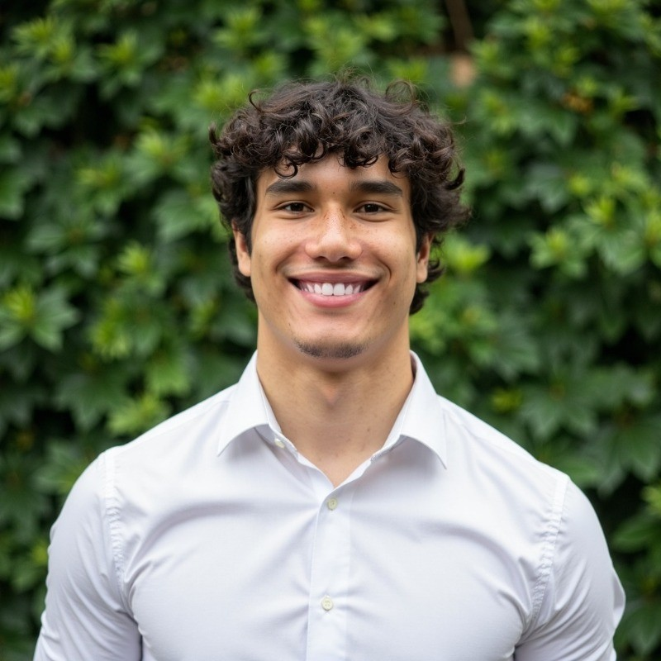
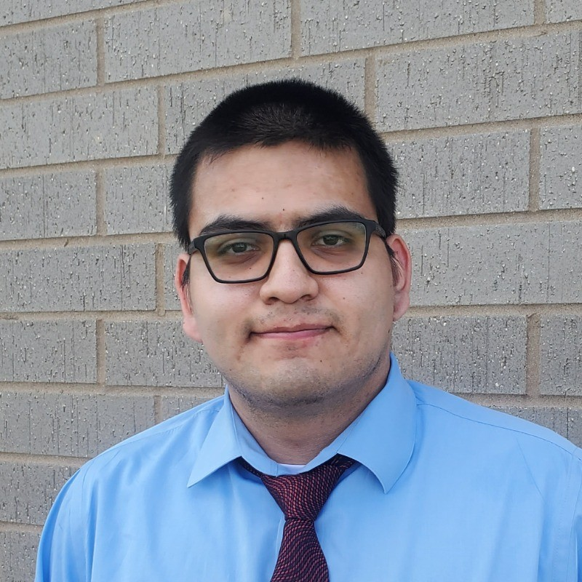



RTX-Team A
About Us
Portfolio
Contact Us
Search
Group 1
David Santos
Kevin Melo
Project Lead
Optimization
AJ Kimbrough
Amelia Quinn
Deployment
Testing & QA
Jay Chung
Andrew Enright
Model Research
UI/UX

